Slide 1

Aberdeen City Council
Homelessness Prevention Tool
Macrodata Refinement
Jake Milne
Denise Mills Neve Murchie
Clara Ringrose

Slide 2
The Aim
LLM chatbot to provide a user-friendly experience and information on resources for homelessness and its causes in Aberdeen

Slide 3
The ??
Web app: mobile first, accessible, fast (probably), scalable
AI: currently OpenAI, could be hosted locally
TXT: ?????????????????

Slide 4
Demonstration

Slide 5
Security
LLM Prompt Injection (AML.T0051): Guidelines are in place to prevent unauthorised use
Data handling/storage: application does not store data or user input, but it is sent to OpenAI, would not be an issue with self-hosting
Other stuff

Slide 6
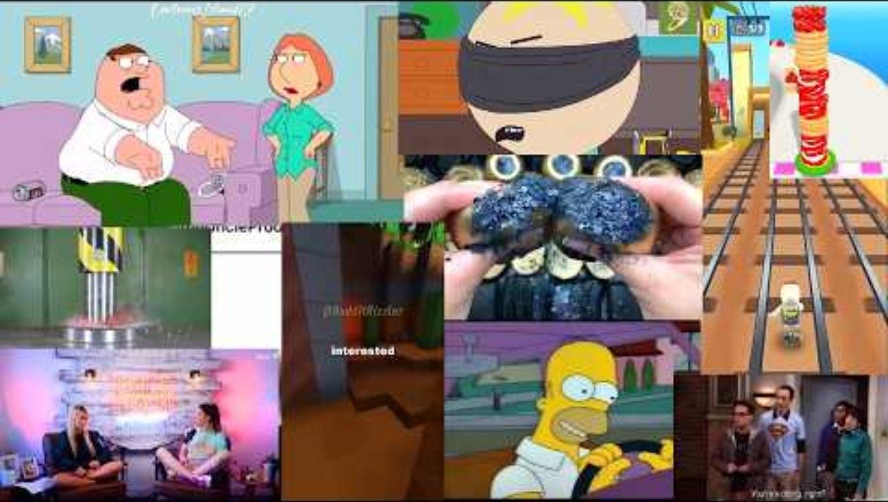
Hallucinations
Retrieval-Augmented Generation (RAG): giving language models external data to improve results*
“Prompt engineering” (being mean to robots): we harassed chatgpt into being good
Thorough testing: The language model always provided accurate data and refused to try answer anything outside of the scope of the RAG data.
Lewis, P., Perez, E., Piktus, A., Petroni, F., Karpukhin, V., Goyal, N., Küttler, H., Lewis, M., Yih, W.-T., Rocktäschel, T., Riedel, S., Kiela, D., Facebook and Research, A. (n.d.). Retrieval-Augmented Generation for Knowledge-Intensive NLP Tasks. [online] Available at: http://arxiv.org/pdf/2005.11401.

Slide 7
Accessibility
Screen reader friendly
Mobile first design
Multiple language support

Slide 8
Next Steps
Deploy local instance of Llama
Accessibility
Web scraping to automatically update source data

